Slide 1
Understanding Web Applications
Lesson 4

Slide 2
Objective Domain Matrix
Skills/Concepts | MTA Exam Objectives
Understanding Web Page Development | Understand Web page development (4.1)
Understanding ASP.NET Application Development | Understand Microsoft ASP.NET Web Application development (4.2)
Understanding IIS Web Hosting | Understand Web hosting (4.3)
Understanding Web Services Development | Understand Web Services (4.4)
Notes:
Tip: Add your own speaker notes here.

Slide 3
HTML
Hypertext Markup Language (HTML) is the language used by Web servers and browsers to describe a Web page.
An HTML page has two distinct parts: a header and a body.
HTML tags define the structure and content of a page. Each starting tag has a matching ending tag. For example, the ending tag for <html> is </html>.
The header is enclosed within the <head> and </head> tags.
The body is enclosed within the <body> and </body> tags
Notes:
Tip: Add your own speaker notes here.

Slide 4
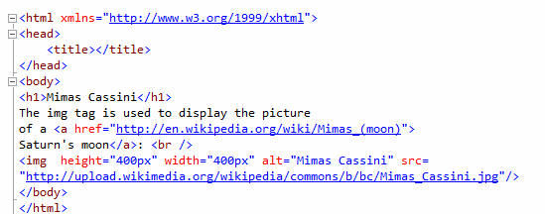
HTML Example

Slide 5
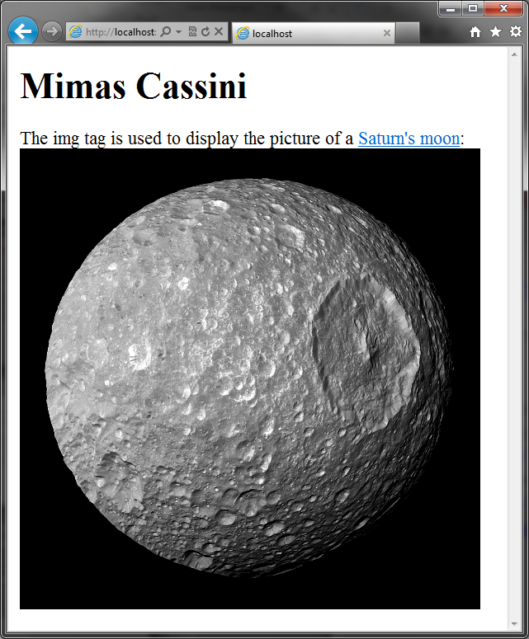
HTML Output

Slide 6
Cascading Style Sheets
Cascading style sheets (CSS) is a language that describes information about displaying a Web page.
CSS enable you to store a Web page’s style and formatting information separate from the HTML code.
HTML specifies what will be displayed whereas CSS specifies how that material will be displayed.
When used effectively, CSS is a great tool for increasing site-wide consistency and maintainability.
Notes:
Tip: Add your own speaker notes here.

Slide 7
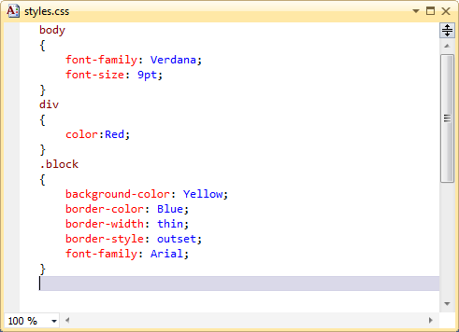
CSS Example

Slide 8
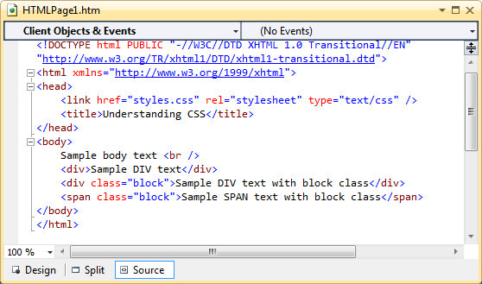
Using the CSS File

Slide 9
JavaScript
JavaScript is a client-side scripting language.
JavaScript runs inside Web browsers. JavaScript is supported by all popular Web Browsers.
Ajax is shorthand for “Asynchronous JavaScript and XML.” Ajax uses JavaScript extensively in order to provide responsive Web applications.
The ASP.NET AJAX framework lets you implement Ajax functionality on ASP.NET Web pages.
Notes:
Tip: Add your own speaker notes here.

Slide 10
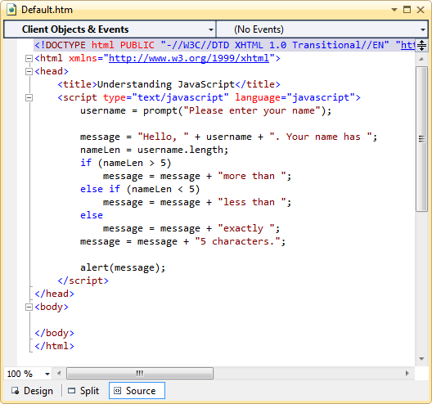
JavaScript Example

Slide 11
Client-Side vs. Server-Side Programming
Client-side programming refers to programs that execute completely on a user’s local computer.
Examples: Windows Forms application, JavaScript code that executes within a Web browser.
Server-side programming refers to programs that are executed completely on a server and make use of the server’s computational resources.
Examples: Web applications and Web services.
Hybrid applications use both client- and server-side programming. Ajax applications use a mix of server-side programming and client-side code to create interactive and highly responsive Web applications.
Notes:
Tip: Add your own speaker notes here.

Slide 12
ASP.NET
ASP.NET is the part of the .NET Framework that enables you to develop Web applications and Web services.
The ASP.NET infrastructure has two main parts:
A set of classes and interfaces that enables communication between the Web browser and Web server. These classes are organized in the System.Web namespace.
A runtime process, also known as the ASP.NET worker process (aspnet_wp.exe), that handles the Web request for ASP.NET resources.
Notes:
Tip: Add your own speaker notes here.

Slide 13
ASP.NET Page Execution
The ASP.NET worker process (aspnet_wp.exe) fulfills the request for ASP.NET page execution.
The ASP.NET worker process compiles the .aspx file into an assembly and instructs the Common Language Runtime (CLR) to execute the assembly.
When the assembly executes, it takes the services of various classes in the .NET Framework class library to accomplish its work and generate response messages for the requesting client.
The ASP.NET worker process collects the responses generated by the execution of the Web page and creates a response packet.
Notes:
Tip: Add your own speaker notes here.

Slide 14
ASP.NET Page Life Cycle
Event | Description
PreInit | Several page properties, such as Request, Response, IsPostBack, and UICulture, are set at this stage.
Init | During the initialization stage, all the controls on the page are initialized and made available.
Load | If the request is a postback, the load stage is used to restore control properties with information from view state and control state.
PreRender | This stage signals that the page is just about to render its contents.
Unload | During the unload stage, the response is sent to the client and page cleanup is performed.

Slide 15
State Management
The state of a Web page is made up of the values of the various variables and controls.
State management is the process of preserving the state of a Web page across multiple trips between browser and server.
State Management Techniques:
Client-side state management
Server-side state management
Notes:
Tip: Add your own speaker notes here.

Slide 16
Client-Side State Management
Client-side techniques use HTML code and the capabilities of the Web browser to store state information on the client computer.
Common client-side state management techniques:
Query Strings
Cookies
Hidden Fields
View State
Notes:
Tip: Add your own speaker notes here.

Slide 17
Query Strings
Query strings stores the data values in the query string portion of a page URL. For example, the following URL embeds a key (“q”) and its value (“television”) in query string: http://www.bing.com/search?q=television.
To retrieve the value of the key in an ASP.NET page, use the expression:
Request.QueryString["q"].
QueryString is a property of the Request object, and it gets the collection of all the query-string variables and their values.
Notes:
Tip: Add your own speaker notes here.

Slide 18
Cookies
Cookies are small packets of information that are stored by a Web browser locally on the user’s computer. Cookies are commonly used for storing user preferences.
To add a Cookie:
HttpCookie cookie = new HttpCookie("Name", "Bob");
cookie.Expires = DateTime.Now.AddMinutes(10);
Response.Cookies.Add(cookie);
To read a cookie:
if (Request.Cookies["Name"] != null)
{
name = Request.Cookies["Name"].Value;
}
Notes:
Tip: Add your own speaker notes here.

Slide 19
Hidden Fields
Hidden fields contain information that is not displayed on a Web page but is still part of the page’s HTML code.
Hidden fields can be created by using the following HTML element:
<input type="hidden">
The ASP.NET HTML Server control HtmlInputHidden also maps to this HTML element.
Notes:
Tip: Add your own speaker notes here.

Slide 20
View State
ASP.NET uses View State to maintain the state of controls across page postbacks.
When ASP.NET executes a page, it collects the values of all nonpostback controls that are modified in the code and formats them into a single encoded string. This string is stored in a hidden field in a control named __VIEWSTATE.
View State may increase the size of your page.
View State is enabled by default by you can disable it either at the control level or at the page level.
Notes:
Tip: Add your own speaker notes here.

Slide 21
Server-Side State Management
Server-side state management uses server resources to store state information.
Storing and processing session information on a server increases the server’s load and requires additional server resources to serve the Web pages.
ASP.NET supports server-side state management at two levels:
Session State
Application State
Notes:
Tip: Add your own speaker notes here.

Slide 22
Session State
An ASP.NET application creates a unique session for each user who sends a request to the application.
Session state can be used for temporarily store user data such as shopping cart contents.
Reading from session:
if (Session["Name"] != null)
{
/* additional code here */
}
Writing to session:
Session.Add("Name", TextBox1.Text);
Notes:
Tip: Add your own speaker notes here.

Slide 23
Application State
Application state is used to store data that is used throughout an application.
Application State is not user-specific.
Application state can be accessed through the Application property of the Page class.
The Application property provides access to the HttpApplicationState object.
The HttpApplicationState object stores the application state as a collection of key-value pairs.
Notes:
Tip: Add your own speaker notes here.

Slide 24
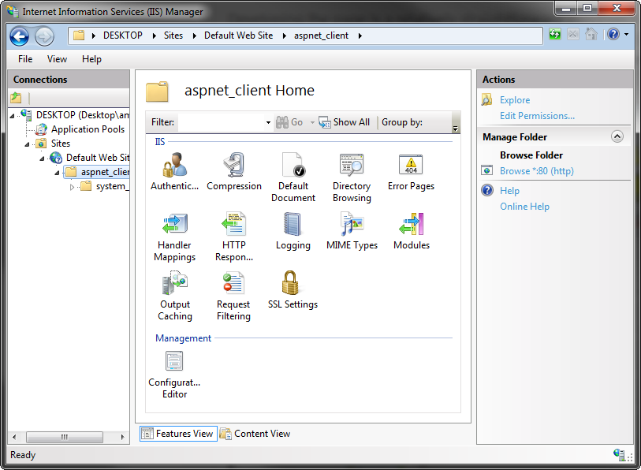
Internet Information Services
Internet Information Services (IIS) is a Web server for hosting Web applications on the Windows operating system.
Notes:
Tip: Add your own speaker notes here.

Slide 25
Web Site & Virtual Directories
An IIS server uses the concepts of sites, applications, and virtual directories.
A Web site (for example: www.northwind.com) is a container of applications and virtual directories.
A virtual directory is an alias that maps to a physical directory on the Web server. For example, in the address www.northwind.com/orders, “orders” is a virtual directory.
A virtual directory maps to a physical directory (for example, c:\inetpub\wwwroot\northwind\orders).
Notes:
Tip: Add your own speaker notes here.

Slide 26
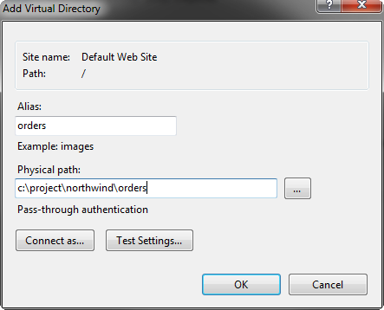
Creating a Virtual Directory
Notes:
Tip: Add your own speaker notes here.

Slide 27
Deploying Web Applications
Xcopy or FTP
For simple websites that require simply copying the files.
Windows Installer
For complex websites that require custom actions during the deployment process. Windows Installer can create virtual directories, restart services, register components, etc.
Notes:
Tip: Add your own speaker notes here.

Slide 28
Web Services
Web services provide a way to interact with programming objects located on remote computers.
Web services are based on standard technologies and are interoperable.
Key technologies:
Hypertext Transmission Protocol (HTTP)
Extensible Markup Language (XML)
Simple Object Access Protocol (SOAP)
Web Services Description Language (WSDL)
Notes:
Tip: Add your own speaker notes here.

Slide 29
SOAP
SOAP is the protocol that defines how remote computers exchange messages as part of a Web service communication.
Message format: XML
XML is easier for otherwise non compatible systems to understand.
Message transmission: HTTP
HTTP, they can normally reach any machine on the Internet without being blocked by firewalls.
Notes:
Tip: Add your own speaker notes here.

Slide 30
WSDL
WSDL stands for Web Services Description Language.
A WSDL file acts as the public interface of a Web service and includes the following information:
The data types it can process
The methods it exposes
The URLs through which those methods can be accessed
Notes:
Tip: Add your own speaker notes here.

Slide 31
Creating Web Services
Inherit from System.Web.Services.WebService
Mark the class with a WebService attribute
Mark the methods with WebMethod attribute
[WebService(Namespace = "http://northwindtraders.com/")]
[WebServiceBinding(ConformsTo= WsiProfiles.BasicProfile1_1)]
public class TextWebService : System.Web.Services.WebService
{
[WebMethod]
public string ToUpper(string inputString)
{
return inputString.ToUpper();
}
}
Notes:
Tip: Add your own speaker notes here.

Slide 32
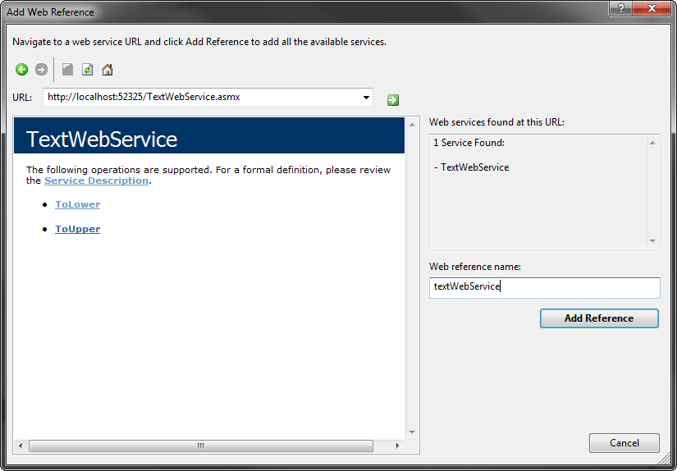
Consuming Web Services
Add a reference to the Web service by using the Add Web Reference dialog Box.
Notes:
Tip: Add your own speaker notes here.

Slide 33
Consuming Web Services
The proxy object allows you to invoke Web service methods.
protected void Button1_Click(object sender, EventArgs e)
{
var webService = new textWebService.TextWebService();
toLowerLabel.Text = webService.ToLower(TextBox1.Text);
toUpperLabel.Text = webService.ToUpper(TextBox1.Text);
}
Notes:
Tip: Add your own speaker notes here.

Slide 34
Recap
Web Page Development
HTML, CSS, JavaScript
Client-side vs. server-side programming
ASP.NET Page Life Cycle
PreInit, Init, Load, PreRender, and Unload
State Management
Query strings, cookies, hidden fields, viewstate
Session state, application state
IIS Web Hosting
Web Sites, Virtual directories
Web Services
SOAP, WSDL
WebService attribute, WebMethod attribute

